Slide 1
Real Algorithm
Just started

Slide 2
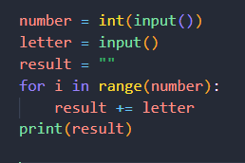
Write code following output below
Case 1
> 2
>​ A
AA
Case 2
> 5
> B
BBBBB

Slide 3
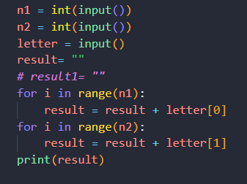
Write code following output below
Case 1
> 2
>​ 4
> AB
AABBBB
ONLY 2 LETTER ALLOW
Case 2
> 5
> 2
> EF
EEEEEFF

Slide 4
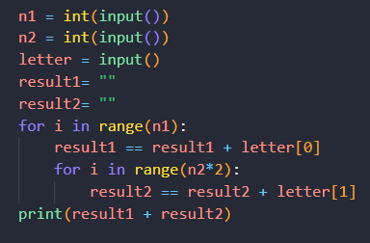
Write code following output below
Case 1
> 2
>​ 4
> AB
AABBBBBBBB
ONLY 2 LETTER ALLOW
Case 2
> 2
> 2
> EF
EEFFFF

Slide 5
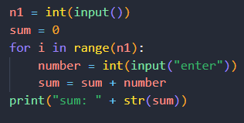
Write code following output below
Case 1
> 4
>​ Enter: 2
>​ Enter: 4
>​ Enter: 4
>​ Enter: 6
Sum: 16
Case 2
> 2
>​ Enter: 2
>​ Enter: 4
Sum: 6

Slide 6
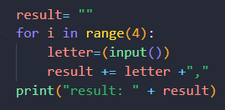
Write code following output below
Case 1
>​ Enter: Hello
>​ Enter: Hi
>​ Enter: Morning
>​ Enter: Good night
Result: Hello, Hi, Morning, Good night
Allow only one print
Case 2
>​ Enter: Yes
>​ Enter: Hi
>​ Enter: Not well
>​ Enter: Okay
Result: Yes, Hi, Not well, Okay

Slide 7
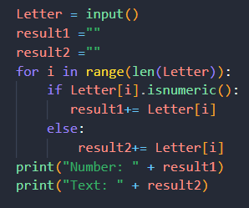
Write code following output below
Case 1
>​ Enter: abc93sa
Number: 93
Text: abcsa
Case 2
>​ Enter: 192abcfj99
Number : 19299
Text: abcfj

Slide 8
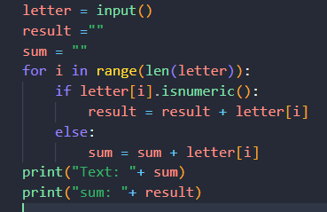
Write code following output below
Case 1
>​ Enter: abc93sa
Sum: 12
Text: abcsa
Case 2
>​ Enter: 192abcfj99
Sum : 30
Text: abcfj

Slide 9
Write code following output below
Case 1
>​ Enter: 98473521
12345789
Case 2
>​ Enter: 1923849
1234899

Slide 10
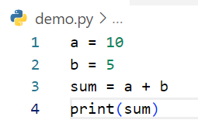
Write step following code below
Step | a | b | sum | output
1 | 10
2 | 10 | 5
3 | 10 | 5 | 15
4 | 10 | 5 | 15 | 15
Example

Slide 11
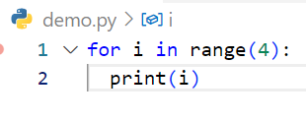
Write step following code below
Step | i | output
1 | 0
2 | 0 | 0
3 | 1
4 | 1 | 1
5 | 2
6 | 2 | 2
7 | 3
8 | 3 | 3

Slide 12
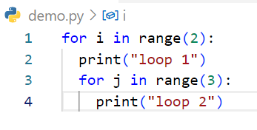
Step | i | j | output
1 | 0
2 | 0 |  | loop 1
3 | 0 | 0
4 | 0 | 0 | loop 2
5 | 0 | 1
5 | 0 | 1 | loop2
6 | 0 | 2
7 | 0 | 2 | loop2
8 | 1
9 | 1 |  | loop1
10 | 1 | 0
11 | 1 | 0 | loop 2
12 | 1 | 1
13 | 1 | 1 | loop2
14 | 1 | 2
15 | 1 | 2 | loop2
Write step following code below

Slide 13
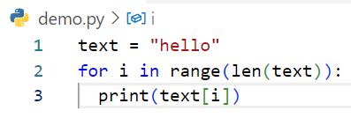
Write step following code below
Step | text | Text[i] | i | output
1 | hello
2 | hello |  | 0
3 | hello | h | 0 | h
4 | hello |  | 1
5 | hello | e | 1 | e
6 | hello |  | 2
7 | hello | l | 2 | l
8 | hello |  | 3
9 | hello | L | 3 | l
10 | hello |  | 4
11 | hello | O | 4 | o

Slide 14
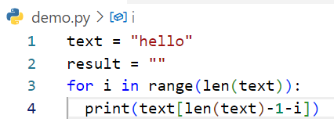
Write step following code below
Step | i | text | Text[let(tiext)-i-i]) | result | output
1 |  | hello
2 |  | hello |  | ‘’’’
3 | 0 | hello |  | “”
4 | 0 | hello | o | “” | o
5 | 1 | hello |  | “”
6 | 1 | hello | l | “” | l
7 | 2 | hello |  | “”
8 | 2 | hello | l | “” | l
9 | 3 | hello |  | “”
10 | 3 | hello | e | “” | e
11 | 4 | hello |  | “”
12 | 4 | hello | h | “” | h

